Slide 1
Regulation of Eukaryotic Transcription

Slide 2
Outline:
Overview
Structural classification of eukaryotic transcription factors
Transcription control mechanicms
-by altered states of chromatin
-through Mediator
-by epigenetic mechanisms
Control of transcription factor activity
Nuclear receptors

Slide 3
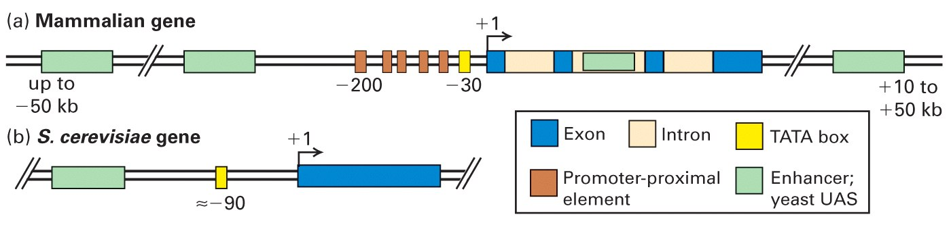
Transcription control elements in eukaryotes
Notes:
UAS- upstream activation sequence Introns – also in yeast, though not so many

Slide 4
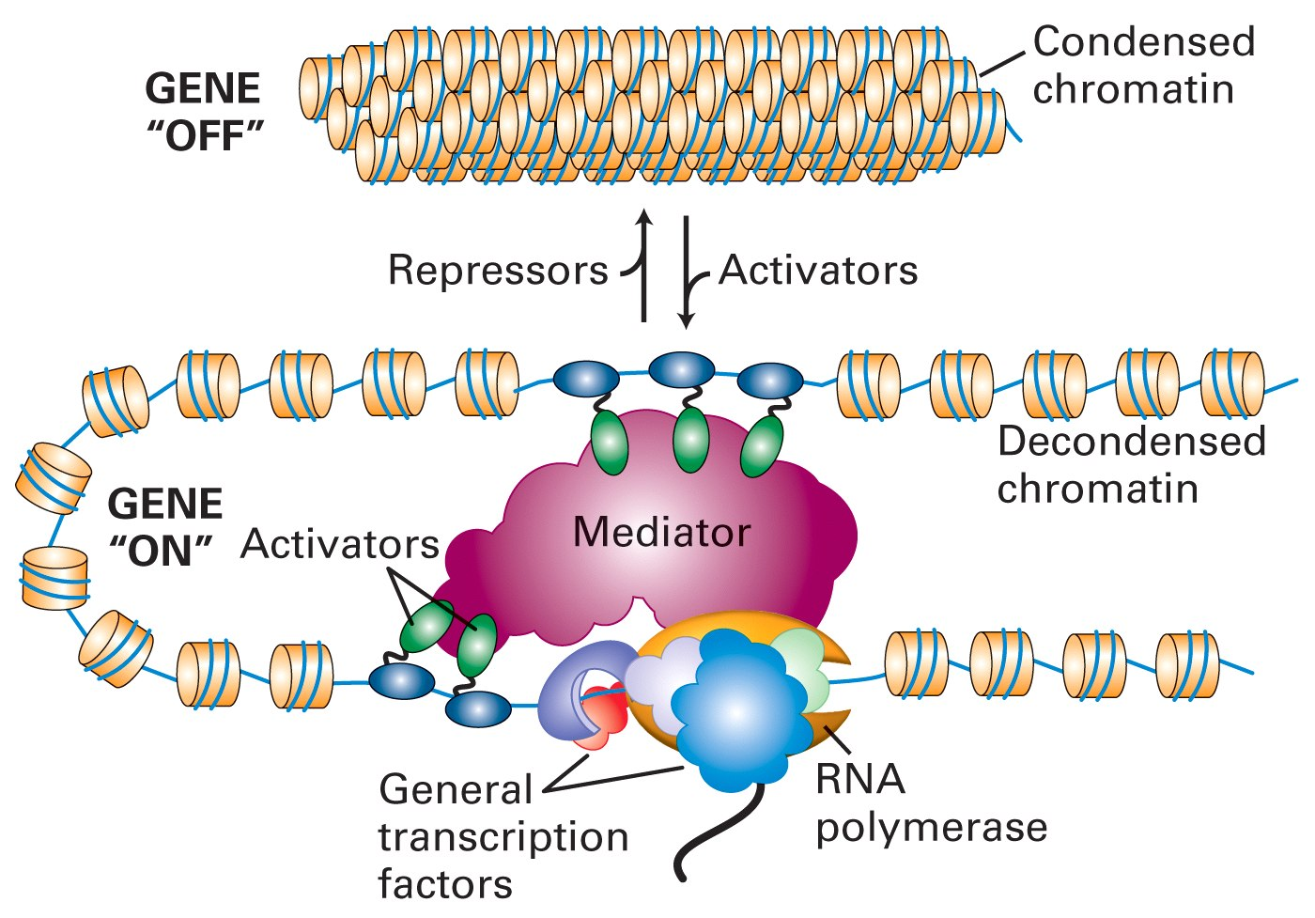
A schematic picture of transcriptional initiation in eukaryotes

Slide 5
Structural classification of specific eukaryotic transcription factor domains

Slide 6
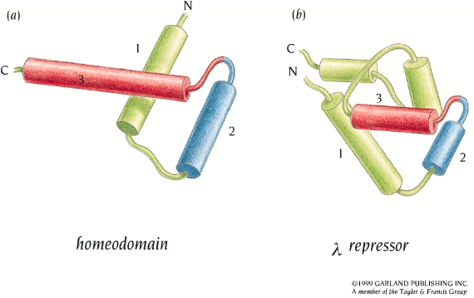
Homeodomains
Sequences of 60 residues that function as DNA binding domains of transcription factors
Built up from 3 helices, where helices 2 and 3 form helix-turn-helix motif similar to those in prokaryotic DNA binding proteins
First identified in Drosophila, where mutant homeodomains cause so-called homeotic transformations. Those are bizarre developmental anomalies – like legs growing from head in place of antennae.

Slide 7
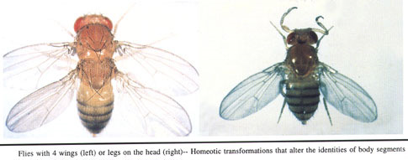
Homeotic transformations

Slide 8
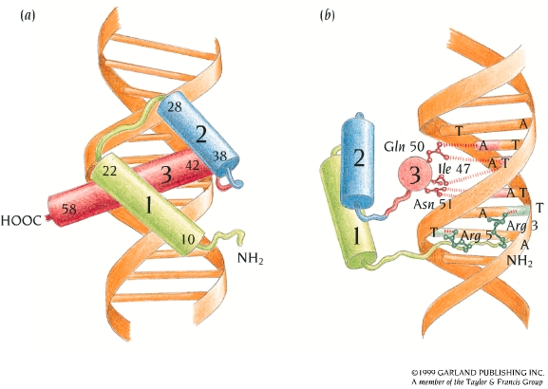
Binding of the helix-turn-helix motif of an Antennapedia homeodomain protein in the major groove of the homeobox
Notes:
in vitro binds to ATTAAT with 1nmol affinity

Slide 9
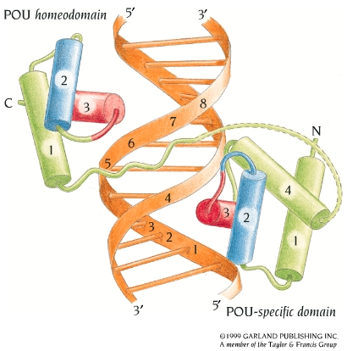
Homeodomains can operate in tandems with similar or different DNA binding domains
DNA binding of the two domains in the POU region of the human protein Oct-1, which regulates transcription of small nuclear RNA genes and the histone H2B gene

Slide 10
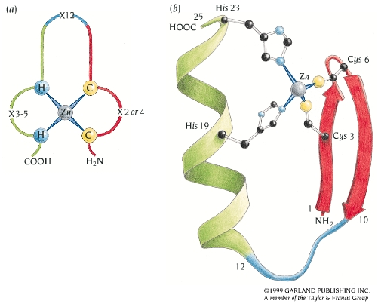
Zinc fingers
The classic zinc finger motif with two histidines and two cysteines binding to the zinc ion (C₂H₂ type)
Other mononuclear zinc finger motifs can have three or four cysteines. The 3D structures of those are quite different from C₂H₂ type.
Notes:
3-10 helice betwwe both histidines

Slide 11
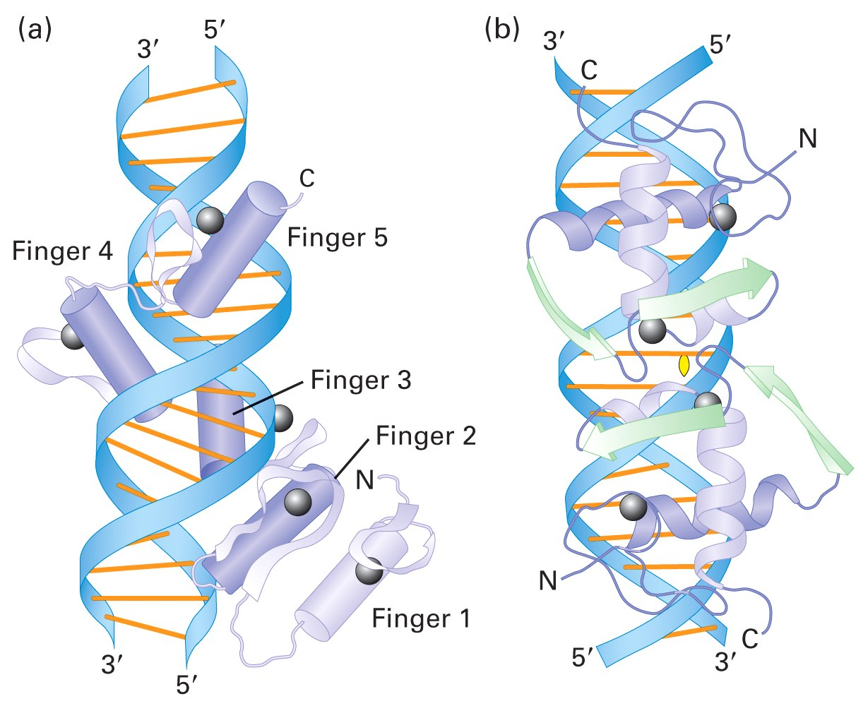
Zinc finger proteins are multi-domain, with 1-60 tandem zinc finger DNA-binding domains and several other domains which may be responsible for dimerization, ligand or other protein binding
Repression
Zn
Zn
Zn
Zn
Zn
Activation
Example: Human GLI1 protein has 5 ZNF domains and additional domains for both transcription activation and repression. Only 4 of 5 ZNFs bind to DNA

Slide 12
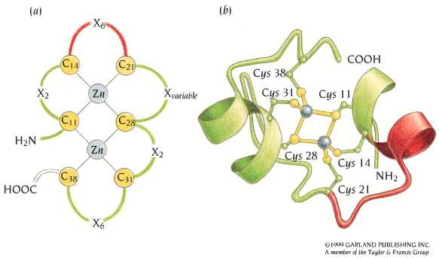
A binuclear zinc finger binding in GAL4
Binuclear zinc finger proteins contain six Cys/His residues and two zinc ions
Notes:
gal4- activates genes for galactose breakdown in yeast

Slide 13
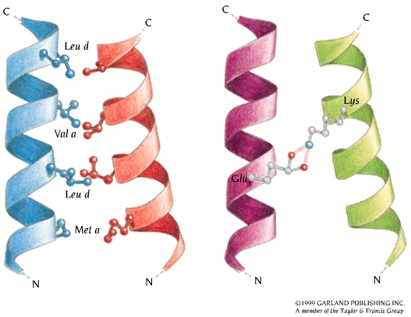
Leucine zippers
Leucine zipper motif is built of two α-helices, which are kept together by hydrophobic interactions. Each seventh residue is leucine, hence the name leucine zipper
Dimer formation can be promoted by additional charge interactions

Slide 14
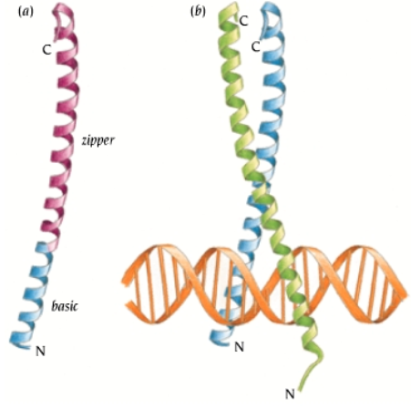
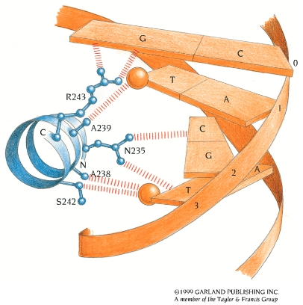
Binding of leucine zippers to DNA
Leucine zipper DNA binding proteins are homo or heterodimers
The C-terminal part of helice contains leucine zipper dimerization region, whereas N-terminal part binds to DNA and contains many basic residues

Slide 15
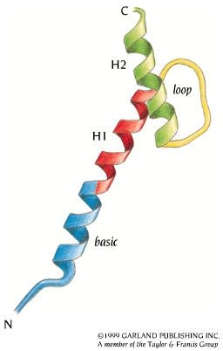
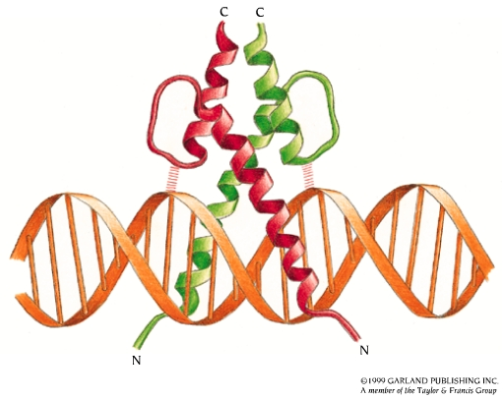
Helix-loop-helix domains
Helix-loop helix domains are somewhat similar to leucine zippers, except that a four-bundle helix motifs hold together basic DNA-binding helices
Notes:
The MyoD protein belongs to this group of transcription factors. This protein and a number of related proteins are involved in the development of muscle cells. They form both homo- and heterodimers

Slide 16
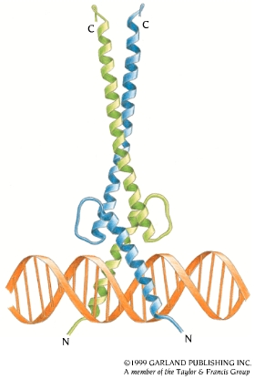
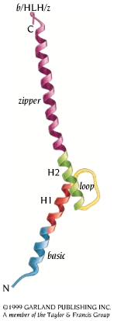
Structure of human oncogene Max is an example of combined leucine zipper – helix-loop-helix protein

Slide 17
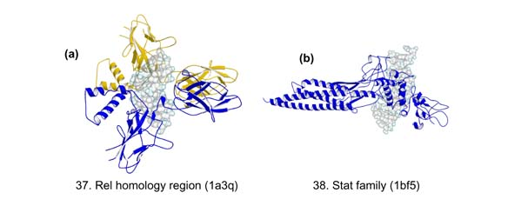
Other eukaryotic DNA-binding domains
Rel homology domains (NFkB, NFAT)
Stat protein family
DNA- binding domains with an immunoglobulin – like fold. Loops, which connect the b-strands, interact with DNA
Notes:
rel – immune system; stat – response to growth factors

Slide 18
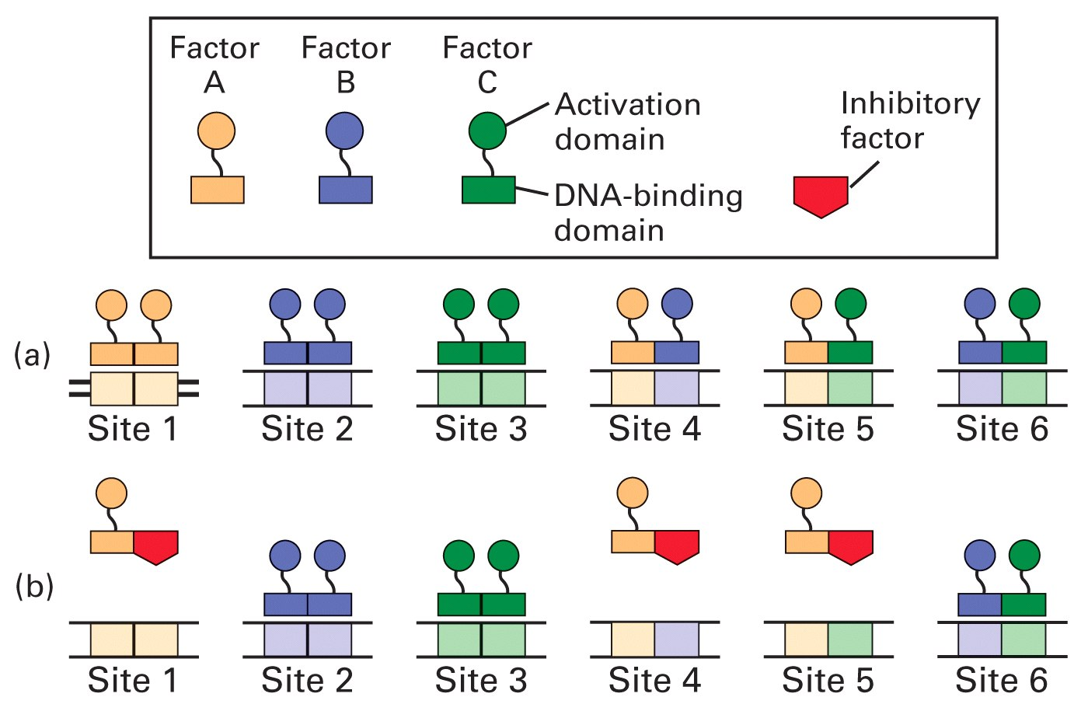
Homo- and heterodimeric combinations of transcription factors
From three different DNA-binding protein monomers it is possible to create six different dimers with distinct binding sites

Slide 19
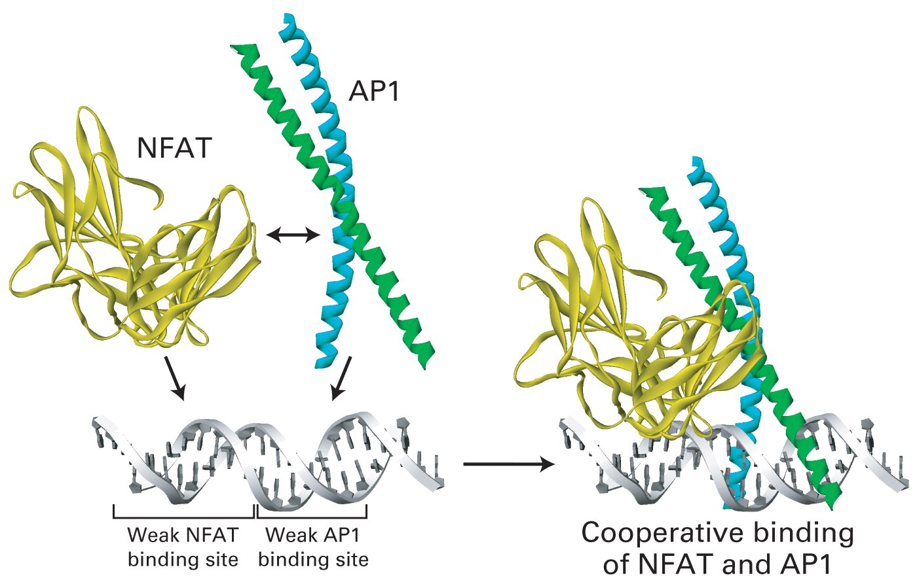
Cooperative binding of NFAT and AP1 transcription factors at IL-2 promoter
Notes:
il2 transcription (both)

Slide 20
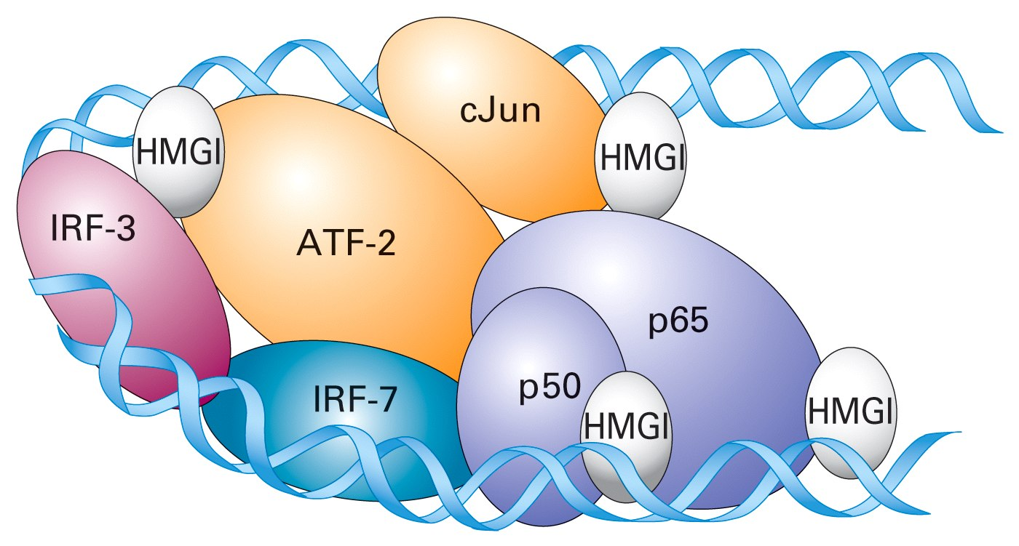
Cooperative binding of specific transcription factors can form an enhancesome
Scheme for enhanceosome formation at b-interferon enhancer. Two monomeric factors IRF3 and IRF7 and two dimeric ATF-2/cJun and p50/p65 (NF-kB). HMGI is sequece-nonspecific factor, which bends DNA by binding in minor groove. It also coordinates the binding of other proteins each to other.

Slide 21
Molecular mechanisms of transcription activation and repression
1. Chromatin mediated transcription control
2. Transcription control through the Mediator
3. Epigenetic control through DNA methylation

Slide 22
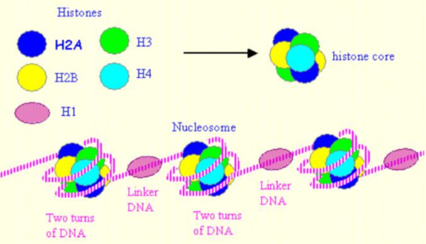
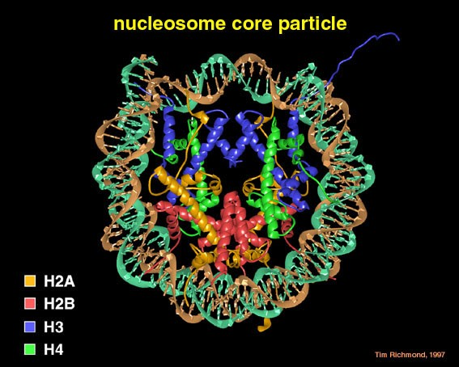
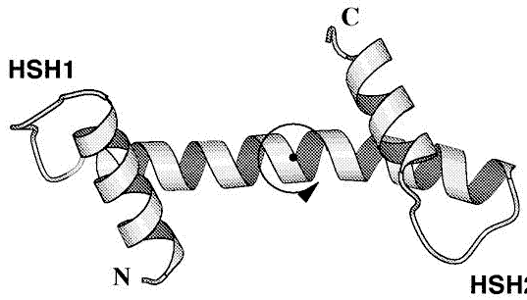
Background: nucleosome structure
Histone monomer

Slide 23
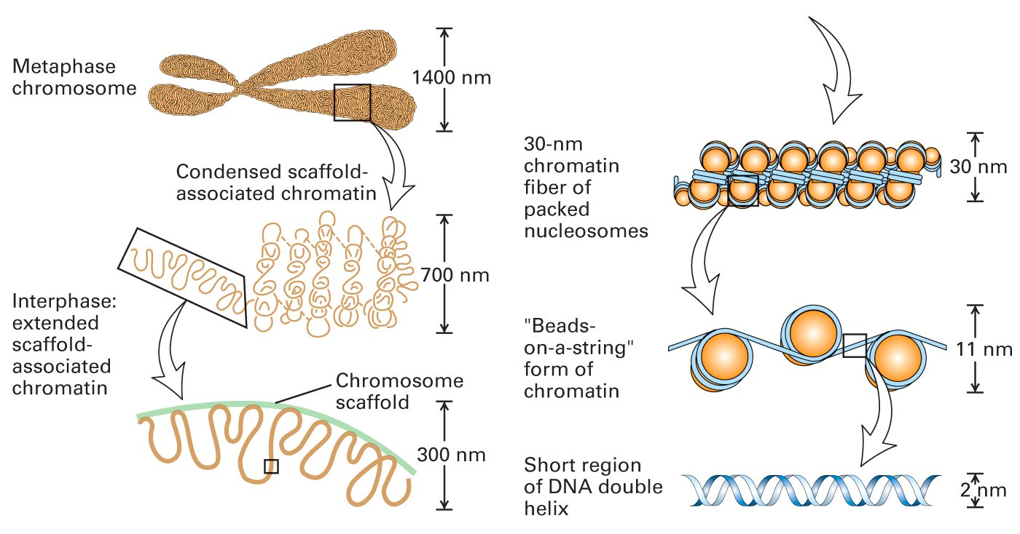
Background: chromatin structure

Slide 24
Acetylation of the N-terminal sequence of histone H3
ARTKQTARKSTGGKAPRKQL
HAT (histone acetyltransferase)
Histone
DNA
O
⁻O-P-O
O
O
⁻O-P-O
O
O
NH₃⁺
NH-C
CH₃
Unacetylated
Acetylated
HDAC (histone deacetylase)

Slide 25
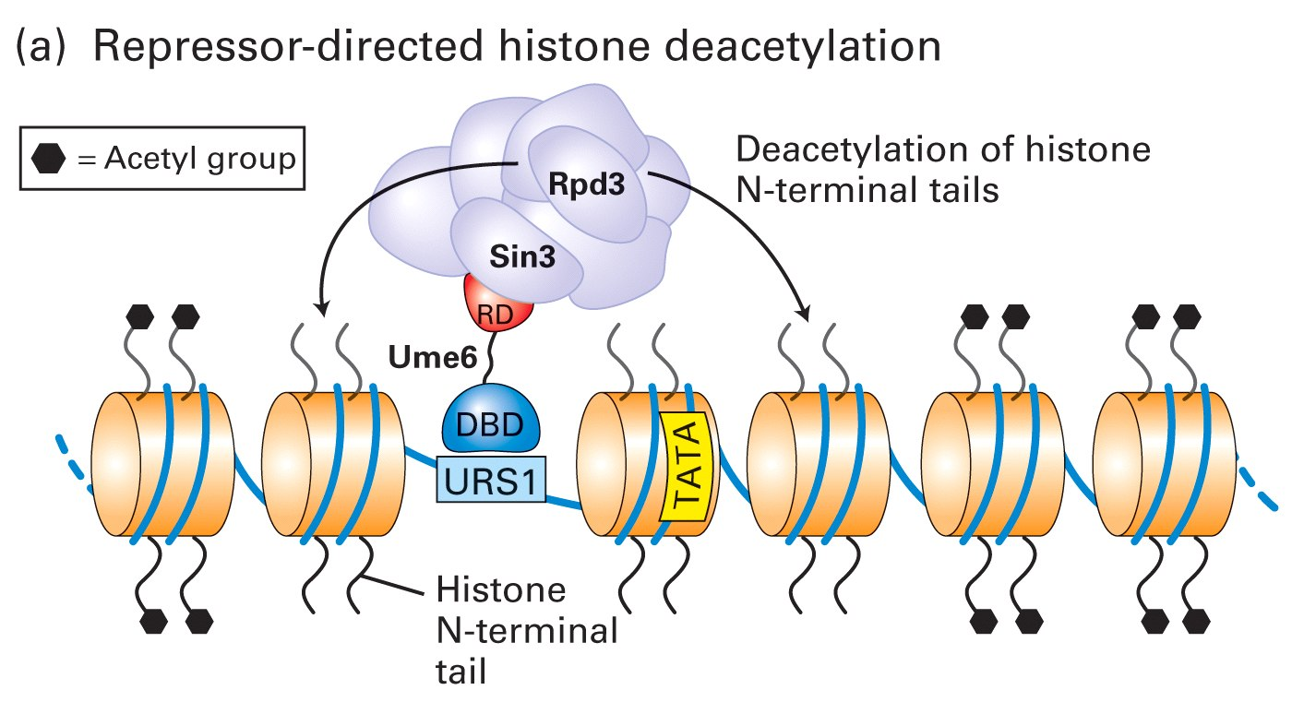
URS1 – Upstream regulatory sequence
DBD and RD – DNA binding and repressor domains of UME6 repressor
RPD3 – yeast histone deacetylase (component of deacetylation complex)
Sin3 – RD binding component of deacetylation complex

Slide 26
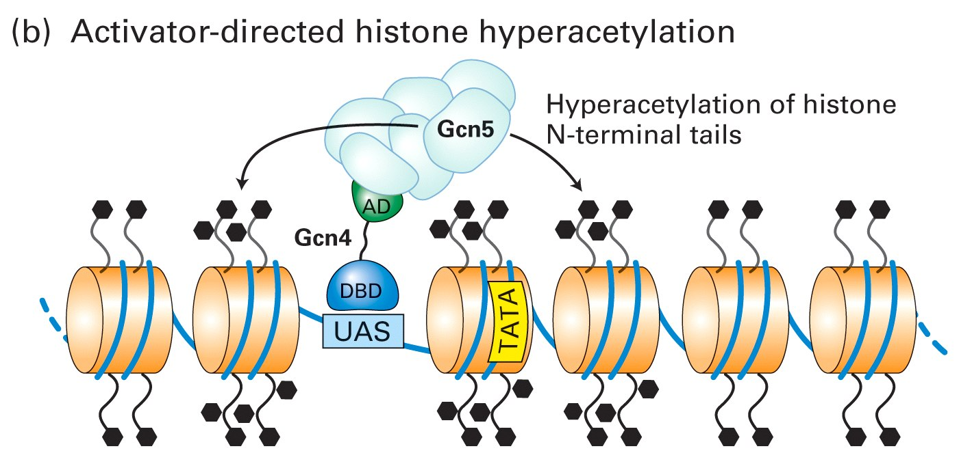
UAS – upstream activation sequence
AD –activation domain of Dcn4 transcription activator
Gcn5 – histone acetylase subunit of acetylation complex

Slide 27
Chromatin remodelling factors
Chromatin remodellig factors are multiprotein complexes with some subunits showing helicase activity
Chromatin remodelling complex SWI/SNF transiently dissociates DNA from the surface of nucleosomes, decondensing the chromatin and making the DNA more accessible to transcription factors
The activity of complex may result also in transcription repression, probably by exposing the histone tails to deacetylases or by assisting in folding of chromatin into higher-order structures

Slide 28
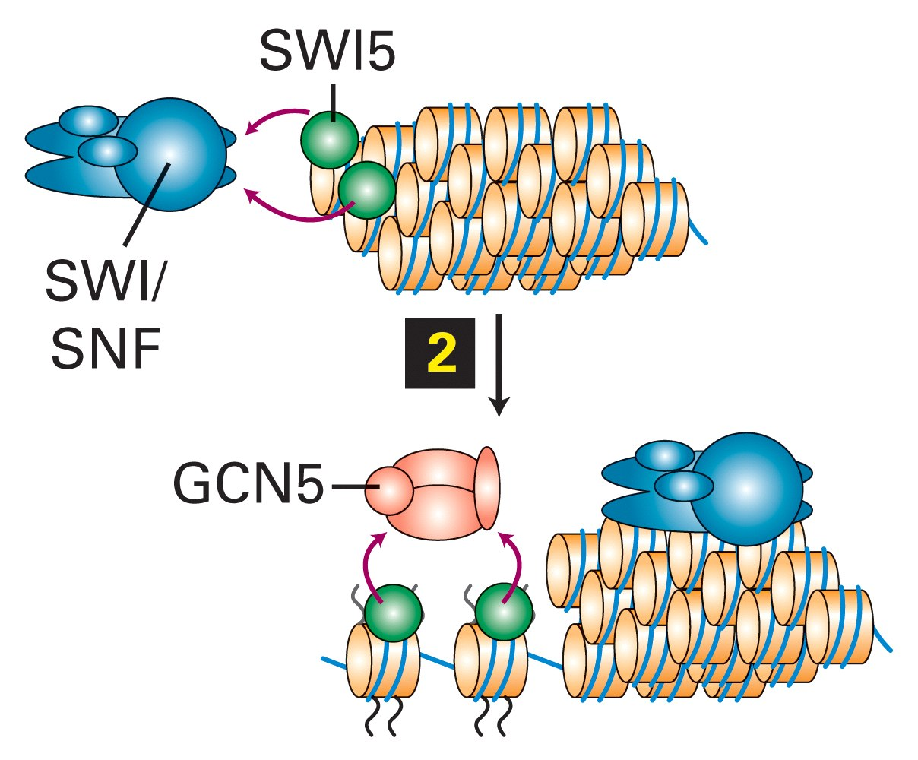
binds to enhancer and recruits SWI/SNF

Slide 29
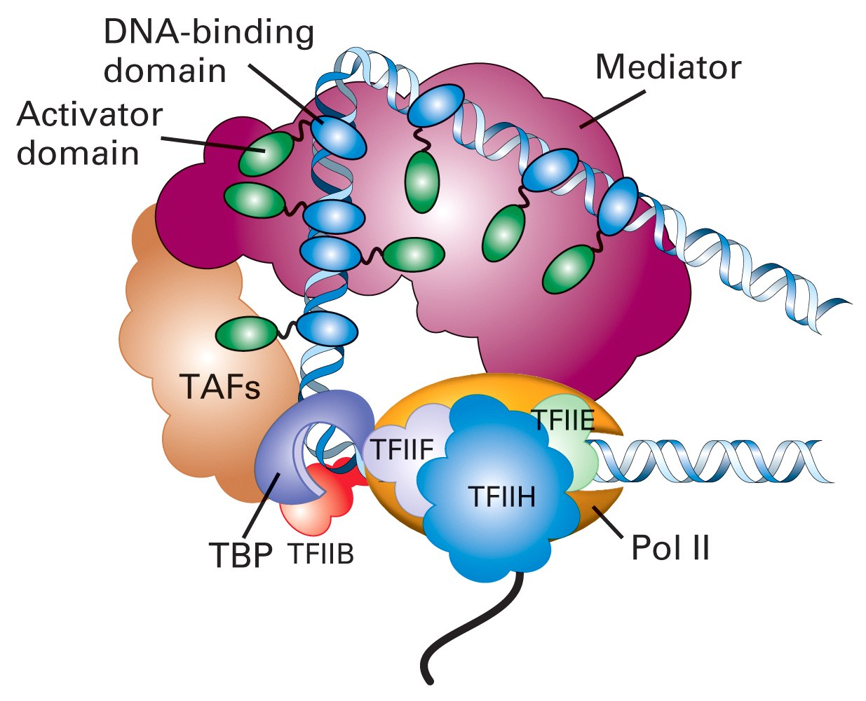
Transcription regulation through Mediator
Notes:
-more direct mechanism
Med – a bridge between polII and activators/repressors

Slide 30
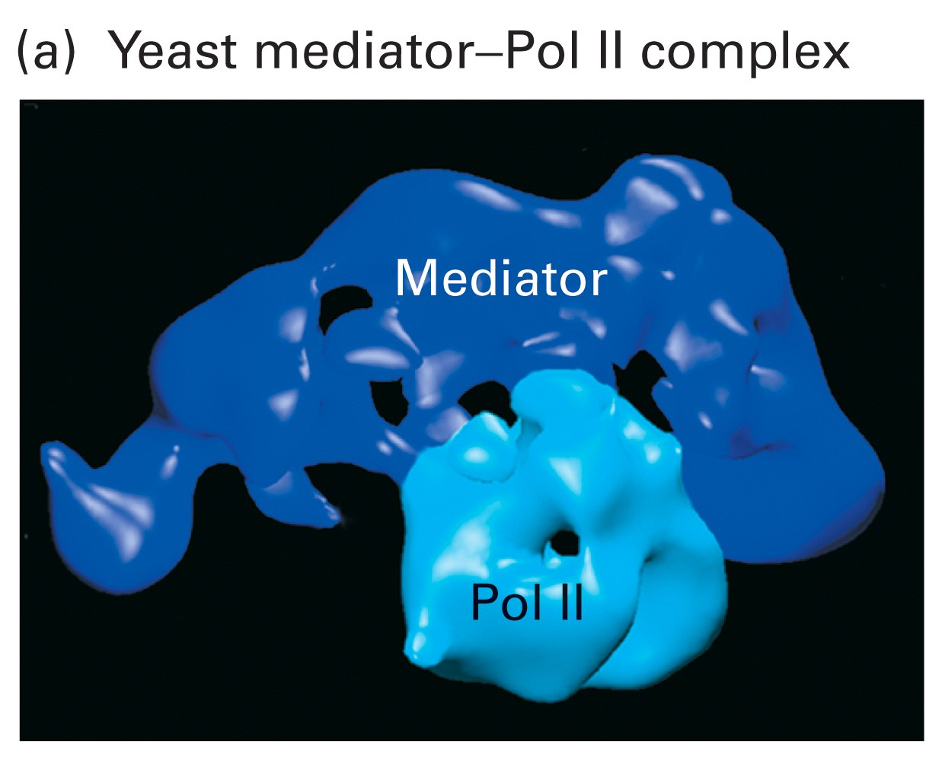
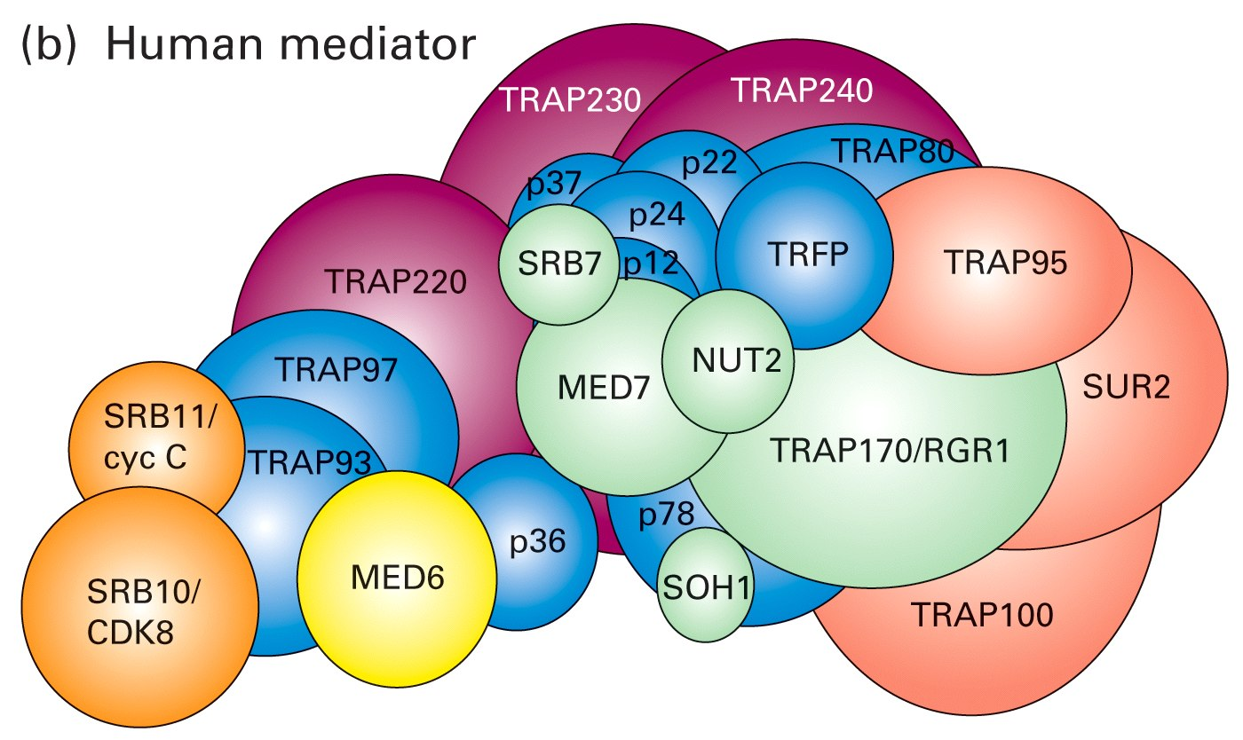
Structure of yeast and human mediator complexes
Composed of ~20 subunits which are arranged in modules
Some subunits interact with RNA Pol II, others – with activators
One subunit has histone acetylase activity which might keep the promoter region in hyperacetylated state
Some subunits are required for expression of all genes (“core subunits”) whereas others are required for specific subsets of genes
Notes:
srb-supresor of rna pol B
h deacet – maintains tata

Slide 31
There is a long way from condensed chromatin to mRNA expression...
Notes:
alpha to a

Slide 32
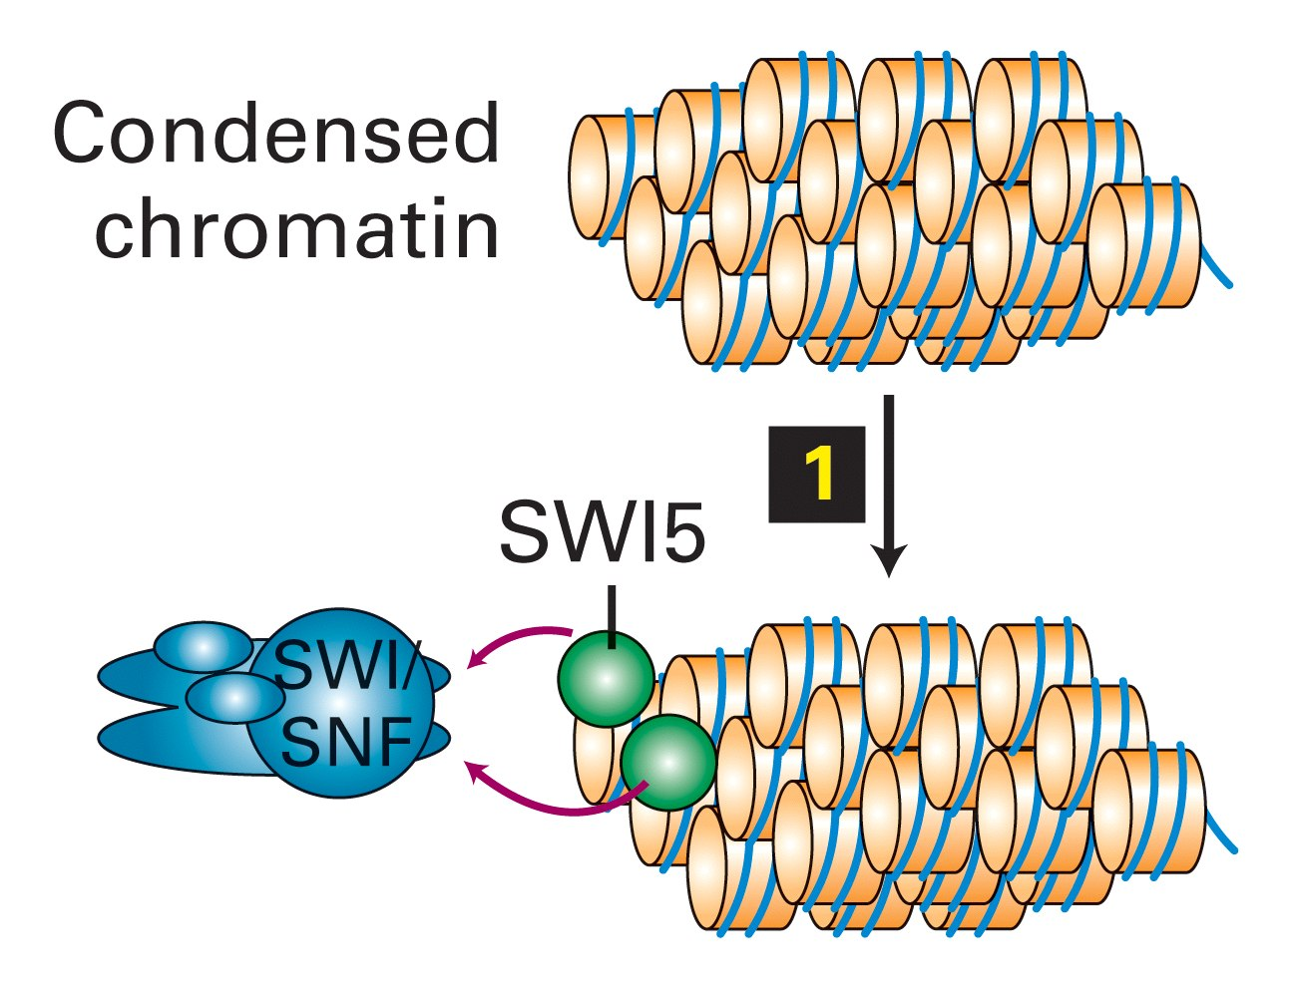
Gene packed in condensed chromatin
SWI5 protein binds to the enhancer sequence and recruits chromatin remodelling complex

Slide 33
SWI/SNF decondenses chromatin and exposes histon tails. Histone acetylases (HAT) get recruited by SWI5

Slide 34
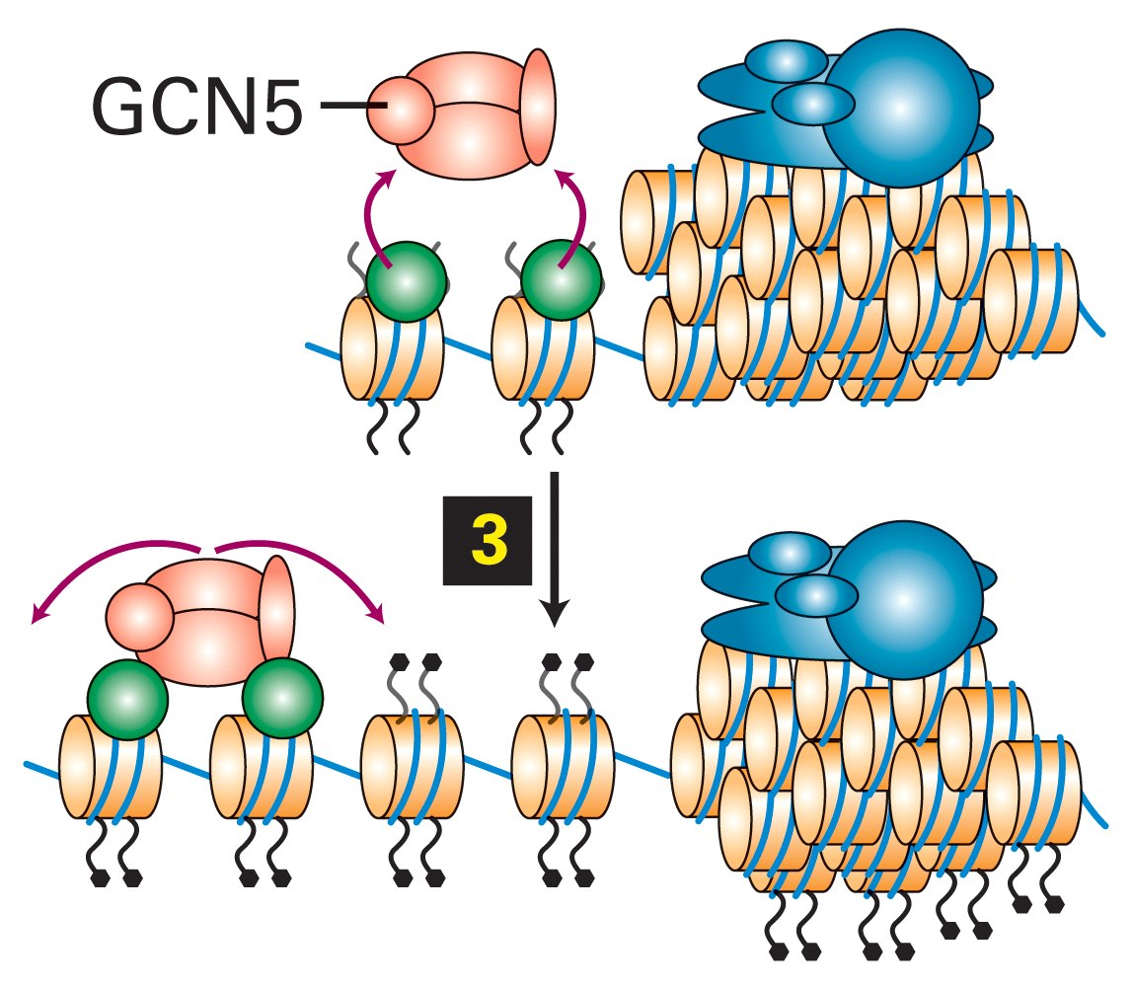
Histone tails get acetylated by GCN5

Slide 35
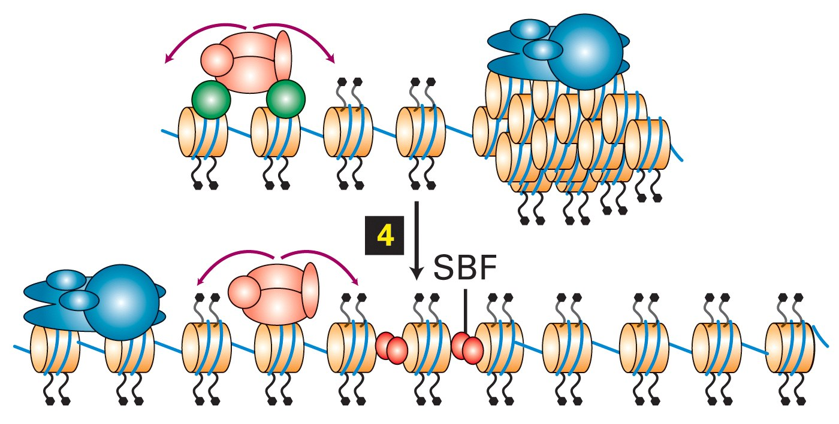
SBF activator gets bound to promoter proximal elements

Slide 36
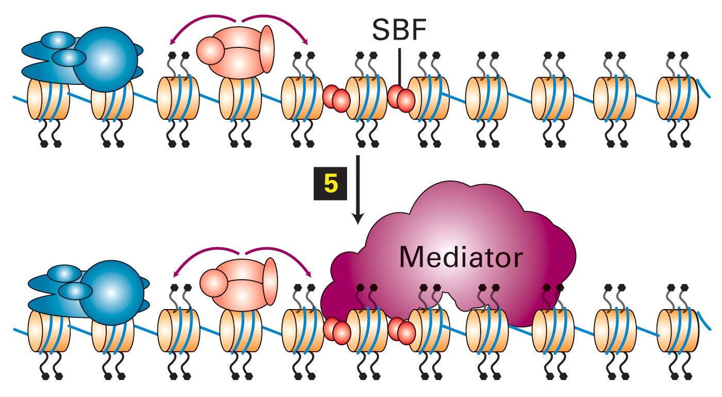
Mediator binds to SBF

Slide 37
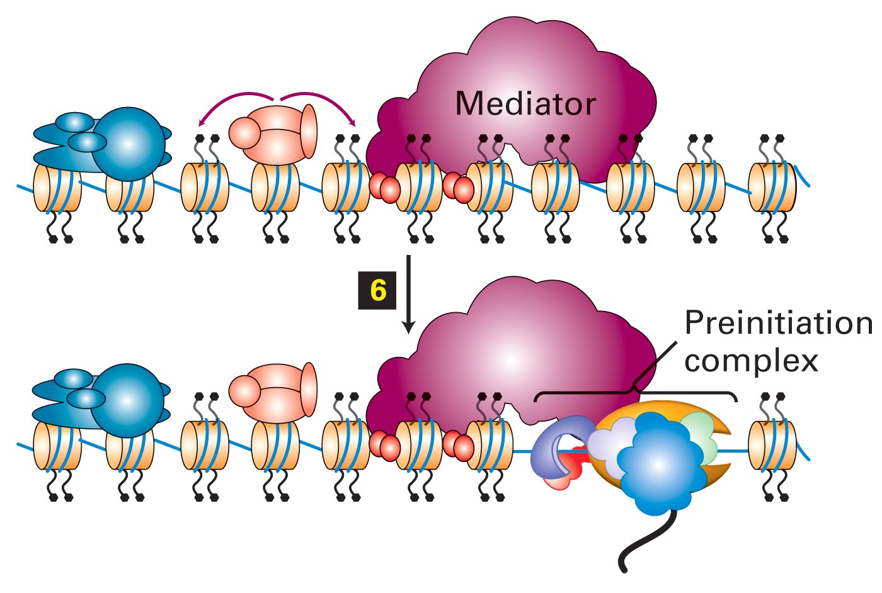
GTFs and pol II bind to TATA box element

Slide 38
Other modifications of histone
Methylation
Ubiquitination
Citrullination
Phosphorylation
Methylation of lysines H3K4 and H3K36 is correlated with transcriptional activation
Demethylation of H3K4 is correlated with silencing of the genomic region.
Methylation of lysines H3K9 and H3K27 is correlated with transcriptional repression.
H3K9me3 is highly correlated with constitutive heterochromatin.

Slide 39
H3-Histone 3; H4-Histone 4; H2B-Histone 2B; K-Lysine
Type of modification
Mono-methylation
Di-methylation
Tri-methylation
Acetylation
H3K4 | H3K9 | H3K14 | H3K27 | H3K79 | H4K20 | H2BK5
Activation | Activation |  | Activation | Activation | Activation | Activation
 | Repression |  | Repression | Activation
Activation | Repression |  | Repression | Act:n Rep:n |  | Repression
 | Activation |  | Activation

Slide 40
Epigenetic control mechanisms
Methylation of DNA and histones

Slide 41
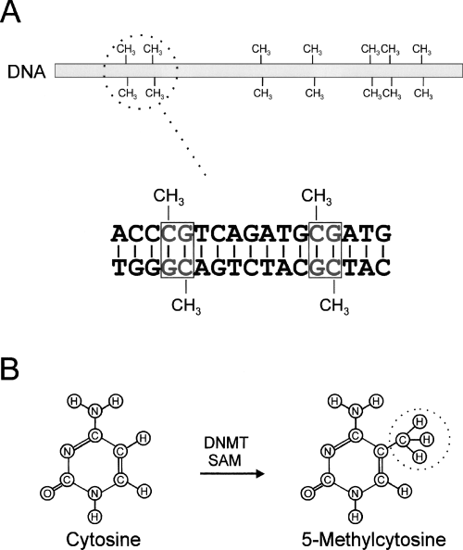
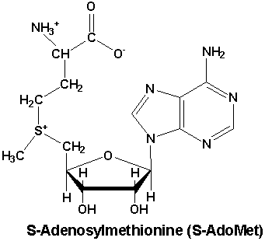
DNA methylation at CpG islands
DNMT – DNA methyltransferase
SAM: S-adenosylmethionine
Notes:
can be and can be not the same CpG islands as for transcr initiation

Slide 42
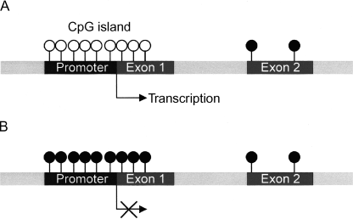
Methylation of CpG islands can block transcription by two distinct pathways:
1. Direct blocking of TFIID binding
Methyl group absent
Methyl group present

Slide 43
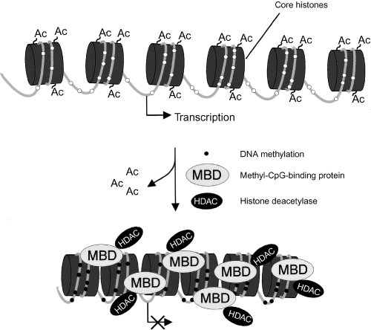
2. Recruitment of histone deacteylases

Slide 44
DNA methylation pattern can be inherited to daughter cells
CH₃
CACTCGTCATT
GTGAGCAGTAA
CH₃
CACTCGTCATT
GTGAGCAGTAA
Replication
CACTCGTCATT
GTGAGCAGTAA
CH₃
CH₃
CH₃
CACTCGTCATT
GTGAGCAGTAA
DNA methyltransferase I
CH₃
Notes:
dna met trI – dependent on existing methyl groups. Other mechanisms are responsible for methylation de novo

Slide 45
Histone modification pattern is also inherited to daughter cells through a poorly understood mechanism
Since DNA methylation is at least sometimes linked to histone modification, conservation of histone pattern in daughter cells might be just a consequence of DNA methylation inheritance
During replication, parental histones are randomly distributed to both daughter chromatides. Modified parental histones might serve as “nests” for modification of non-parental histones

Slide 46
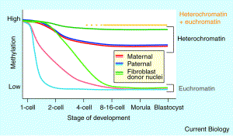
Epigenetic inheritance has some consequences.....
In early stages of embryo development the DNA is actively demethylated
In cloned animals the demethylation pattern seems to be somewhat incomplete
This might be a reason for observed abnormal development of cloned animals
Notes:
demethylation in normal egg cells after fertilization
morula – before uterus, blastocyst – in uterus

Slide 47
Regulation of transcription factor activity
The activity of transcription factors can be regulated by:
(1) covalent modification (phosphorylation, acetylation, ubiquitination,)
(2) by binding to ligands (nuclear receptors)

Slide 48
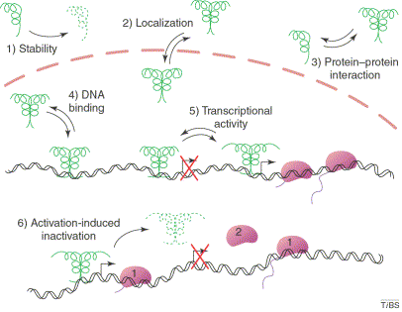
Phosphorylation of transcription factors
Addition or removal of one or several phosphate groups on serine, threonine or tyrosine residues by a protein kinase or protein phosphatase.
Notes:
what is nr 6 ???

Slide 49
Protein p53
p53 (protein 53 kDa) is one of the most frequently cited biomolecules
One of p53 functions is to act as a tumor supressor, which prevents cell division under DNA damaging conditions as exposure to UV light, etc
Knockout mice lacking p53 show normal development, but show predesposition to develop multiple tumors
About half of all 6.5 million people, annually diagnosed for various forms of cancer have mutations in p53 gene

Slide 50
Normal conditions
DNA-damaging conditions
protein kinase ATM
p53
p53
Phosphorylated p53 is stable and quickly accumulates
P
P
Unphosphorylated p53 not stable, p53 controlled genes not activated
transcription
transcription
p53
P
P
Apoptosis
DNA repair
Arrest in G1 phase

Slide 51
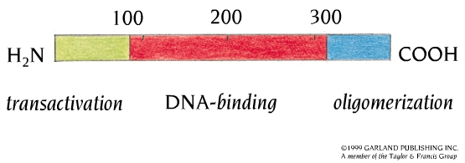
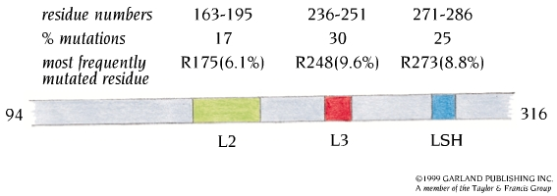
Most p53 cancer associated mutaions occur in DNA binding regions

Slide 52
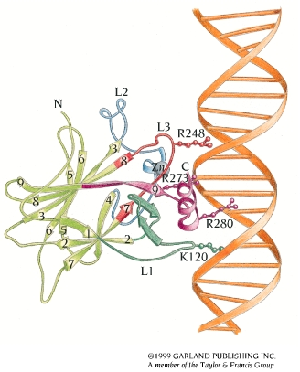
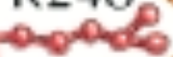
The 3D structure of p53 bound to DNA
K120, R248, R273, R280 –binds directly to DNA. Mutation of any of those leads to decreased affinity
R175 – holds the L3 loop in the correct conformation. Mutation of R175 leads to unfunctional L3 loop
R175

Slide 53
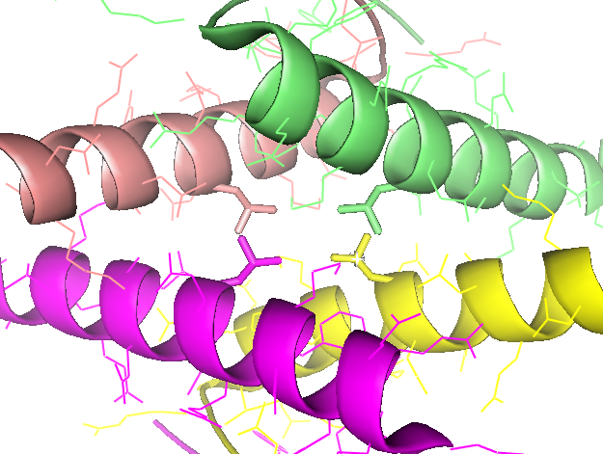
Some p53 cancer associated mutaions occur in tetramerization region
Leu 330

Slide 54
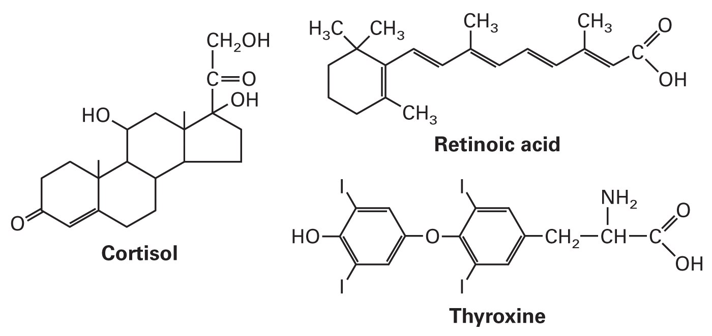
Nuclear receptors
Transcription factors which get activated by lipid-soluble hormones
Lipid-soluble hormones – small hydrophobic molecules capable to diffuse freely through plasma and nuclear membranes

Slide 55
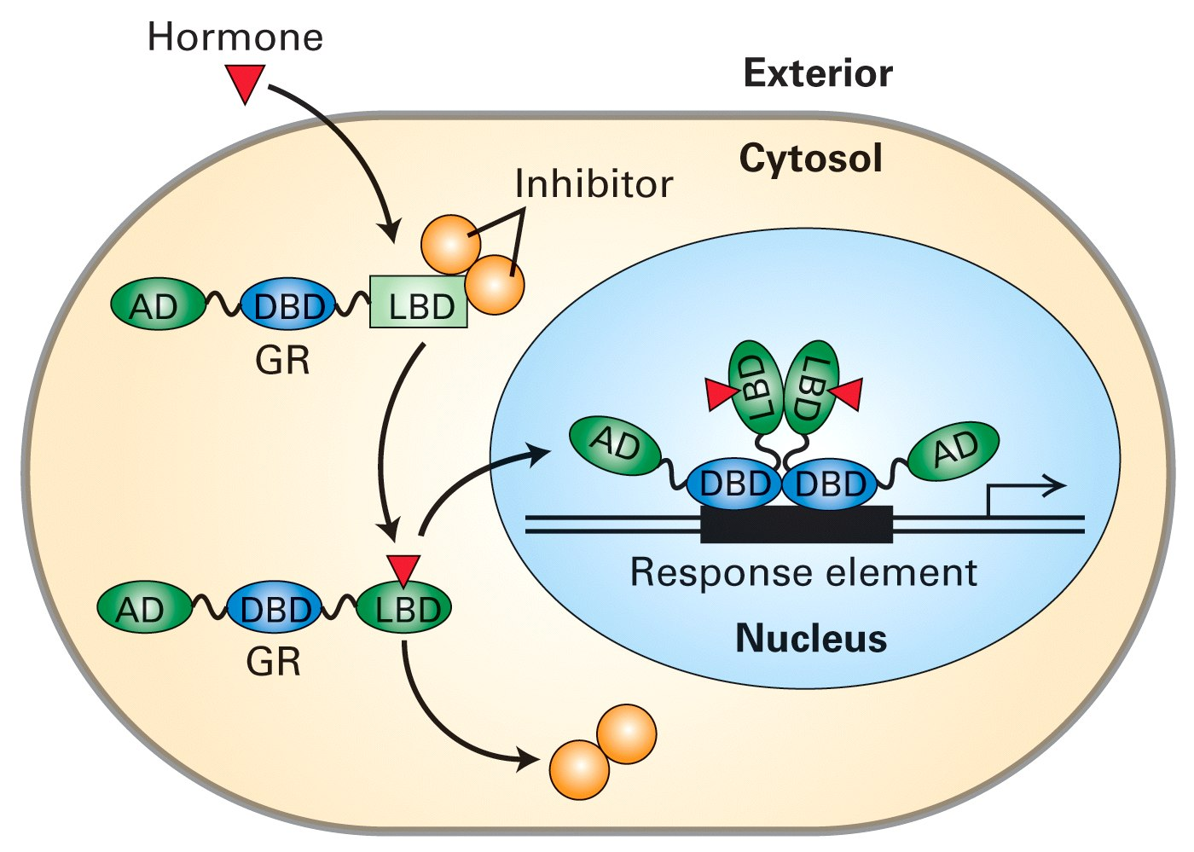
Action of homodimeric nuclear receptors
In the absence of hormone, nuclear receptor is located in cytoplasm
Upon binding to hormone, the nuclear receptor gets transported to nucleus, where it binds to the response element

Slide 56
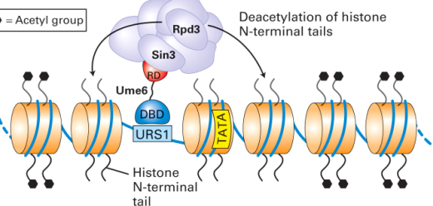
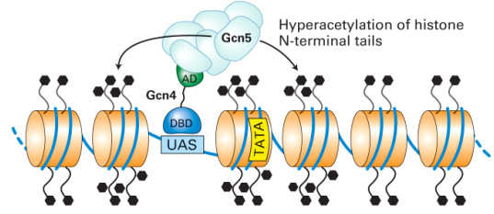
Action of heterodimeric nuclear receptors
HDAC
hnr
HAT
hnr
In the absence of hormone, hnr binds to DNA response element and recruites histone deacetylases. Transcription is blocked.
When hormone diffuses into the nucleus and binds to hnr, histone deacetylase gets released and histone acetylase binds instead. Transcription is activated.

Slide 57
Post-Transcriptional Gene Regulation
1. Gene Regulation of mRNA Processing
-Exon shuffling
-Alternative gene splicing

Slide 58

2. Gene Regulation of mRNA Editing
3. mRNA Longevity
mRNA Transport Control
RNA Interference (RNAi)
→ miRNA
→ siRNA

Slide 59

The left petunia is wild-type; the right petunias contain transgenes that induce suppression of both transgene and endogenous gene expression, giving rise to the unpigmented white areas of the flower.

